Slide 1
SOUTH HUNTINGTON SCHOOL DISTRICT
BUDGET OVERVIEW
BOARD OF EDUCATION MEETING
February 14, 2024

Slide 2
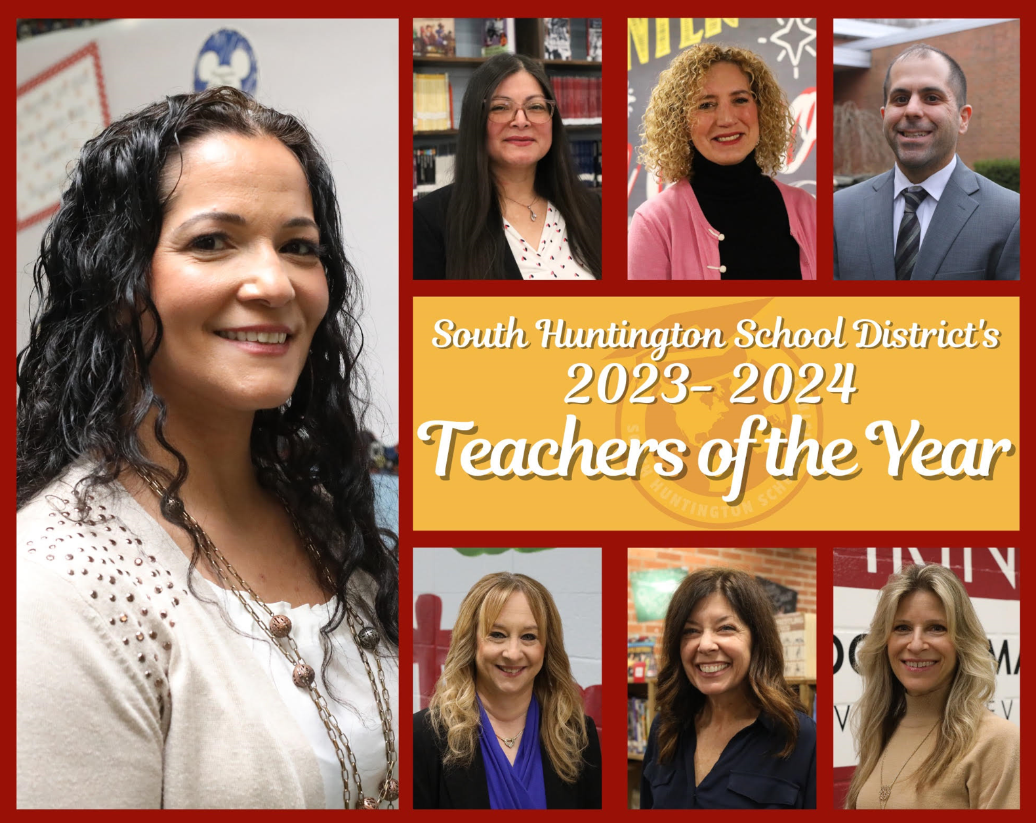
IT’S ABOUT KIDS…STAFF…COMMUNITY
We educate approximately 5,700 students in-district, and employ about 1,200 personnel; including over 550 teachers.
Notes:
Updated 2/5/2024
Ways to support - SHEF
MFM, membership, attending event - they provide many additional opportunities for students that they might not had without SHEF’s donations.

Slide 3
BEGINNING THE 2024/2025 BUDGET JOURNEY
Review of Current Year:
2023/2024
Projecting Next Year:
2024/2025

Slide 4
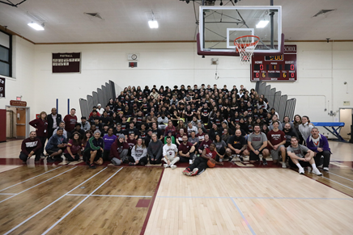
NICHE Rating
Walt Whitman High School
Grade A+
# 3 High School in Suffolk County
South Huntington Union Free School District
Grade A
# 6 District in Suffolk County
Notes:
Updated 2/2/2024
Good Afternoon South Huntington Families,
INCLUDE INFO ON VITO EMAIL FROM NICHE RATINGS
It is my distinct pleasure to announce that Walt Whitman High School is now ranked one of the Top 3 public high schools in Suffolk County, according to the just-released Niche.com 2024 rankings. Walt Whitman High School moved up from last year’s No. 5 placement to rank No. 3 out of 59 public high schools in Suffolk County, while maintaining its A+ rating and is now one of the Top 50 public high schools in New York State, jumping two dozen spots to rank this year at No. 47 out of nearly 1,300 schools statewide. As a whole, the South Huntington School District has also moved up two spots to place No. 6 among Suffolk’s 69 school districts.
Niche.com compiles profiles annually on every school and college in America using the US Department of Education and other public data, plus millions of reviews and ratings from students, parents and teachers to come up with its rankings. In addition to academics, Niche.com grades schools in the areas of administration, teachers, diversity, college prep, sports, clubs and activities, facilities, and nutrition services.
The reason for our district’s successes is the variety of opportunities provided to students, both in and out of the classroom. Walt Whitman High School offers students a wide variety of study through 30 AP (Advanced Placement) courses; 29 college credit courses; Honors courses; Music, Art and Dance; Life Skills for students with special needs; BOCES; Future Teachers; and College and Career Readiness programs, partnering with community businesses in all aspects of industry, medicine, technology, and arts.
For more information on Walt Whitman High School’s 2024 Niche.com ratings, visit Walt Whitman High School in Huntington Station, NY - Niche
For more information on the District’s 2024 Niche.com ratings, visit https://www.niche.com/k12/d/south-huntington-union-free-school-district-ny/
We look forward to the continued successes of both our district and high school for many years to come. We felt that this information would provide all our parents and community members some perspective as to the wonderful things that are going on with our students and school district. As always, if you have any questions please contact your child's principal or myself at any time. Thank you again for your continued support.
Respectfully,
Vito M. D’Elia Ed.D.
Superintendent

Slide 5
2023/2024 CURRENT YEAR INSTRUCTIONAL ADDITIONS
Continued review of Culturally Relevant Literacy - Grades K-12
Implementation of STAR Assessment in the Elementary AIS program
Provides an additional data point for progress monitoring
Expanded student research program: Summer/Grades 7-12
District-wide Professional Development: Instructional Rounds
Site visits
Notes:
Updated 2/2/24

Slide 6
2023/2024 CURRENT YEAR INSTRUCTIONAL ADDITIONS
Continued improvement of course work in all subject areas with the addition of the nine period day at the High School.
Over 30 courses added over the last two years
Focus on student interest and 21st century skills
Addition of vocational programs at the secondary level that focus on Computer Science, Engineering and Automotive.
Continued expansion of internship program at the secondary level to allow students the opportunity to work in fields of interest. (Medicine, Legal, Communications, Accounting, Law Enforcement)
Notes:
Updated 2/2/24

Slide 7
2023/2024 TECHNOLOGY ADDITIONS
Chromebook Replenishment Cycle for Two Grade Levels
Grade 6
Grade 9
MOOV - Student engagement application for students K-12 for Whitman and Stimson
Additional Streaming Hardware in Collaboration with the PR Department
TipWebIT Asset System - Reclaimed assets
Infinite Campus - Reporting Updates/enhancements
Replacement of interactive display boards
Replacement of desktop computers/monitors
Notes:
Updated 2/2/2024

Slide 8
2024/2025 TECHNOLOGY ADDITIONS BEING CONSIDERED
Infrastructure updates:
Firewall
Switches
Controller
Access Points
Camera Replacements - All schools
Cyber Security
Evaluation
Documentation
2 factor authentication
Server expansion/updates
Notes:
Updated 2/2/2024

Slide 9
SOCIAL - EMOTIONAL WELLNESS
In 2023-2024 the district:
Uses Second Step as the SEL curriculum for students in grades K-8.
SEL push-ins and grade level assemblies K-5 with social worker.
Coordinated social/emotional learning (SEL) surveys to students in grades 3-8 (Panorama Education)
In 2024-2025 the district would like to:
Continue the use of Second Step K-8 and look to expand to the 9-12 program.
Expand the focus of the SEL program push-in program from Elementary to Secondary.
Coordinate social/emotional learning (SEL) surveys to students in grades 3-12 (Panorama Education).
Notes:
Updated 2/2/2024

Slide 10
MENTAL HEALTH
Northwell Health Partnership
Community Education
Newsletters
Lunch & Learns
Supports for families to gain access to resources
Support in district PPS teams with referrals for:
Counseling
Psychological evaluations
School avoidance
Enhance the capacity of staff with professional learning opportunities
Notes:
Updated 2/2/2024

Slide 11
SAFETY & SECURITY
The safety of our students, staff and community is paramount and an ongoing focus of the district and we remain committed to maintaining this.
Notes:
Updated 2/2/2024

Slide 12
DISTRICT SAFETY AND SECURITY INITIATIVES
Oversight
Director of Safety and Security with an extensive Law Enforcement and Emergency Services background
Door Entry System and RAVE App
Encoded card access for all employees which allows the Office of Human Resources to control access without issuing new FOBs
Most recently added at the Transportation Building
RAVE App presentations with all staff members
Surveillance Camera and Software Upgrades
Continually upgrading cameras throughout the District and increasing the amount to improve coverage
Security Vestibules
Vestibules completed at Stimson, Silas Wood, Maplewood, Birchwood, Oakwood and Countrywood
Last remaining vestibule will be completed at the James Kaden Administrative Offices in the Spring of 2024 and construction on the Guard Booth at Whitman is pending
Notes:
Updated 2/2/2024

Slide 13
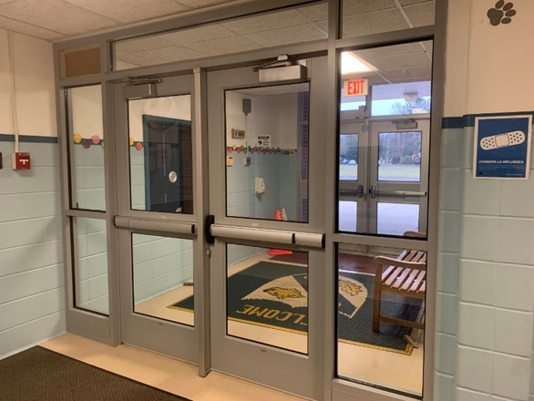
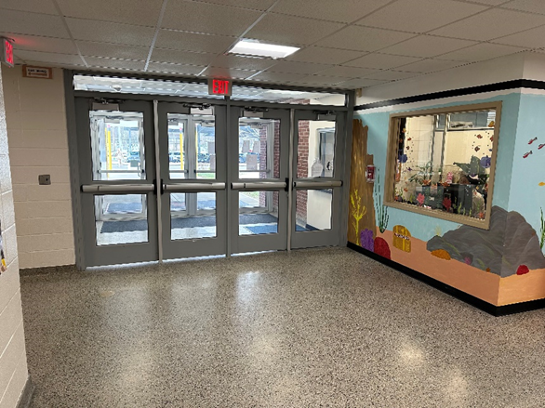
OAKWOOD & COUNTRYWOOD SECURITY VESTIBULES
Notes:
Updated 2/2/2024

Slide 14
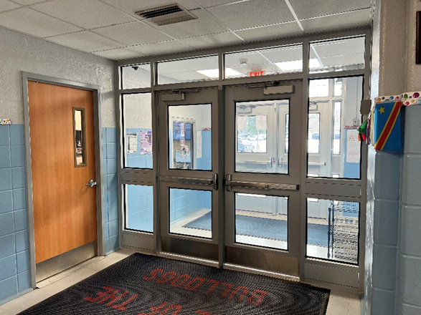
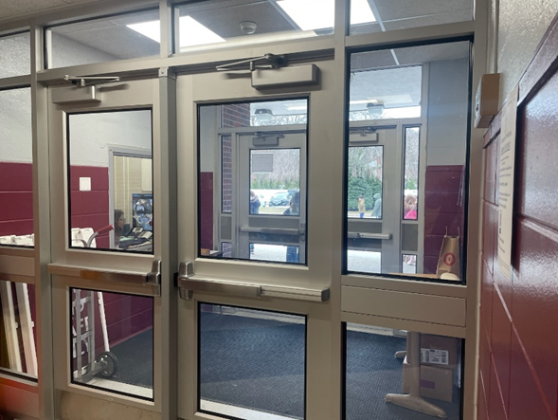
BIRCHWOOD & MAPLEWOOD SECURITY VESTIBULES
Notes:
Updated 2/2/2024

Slide 15
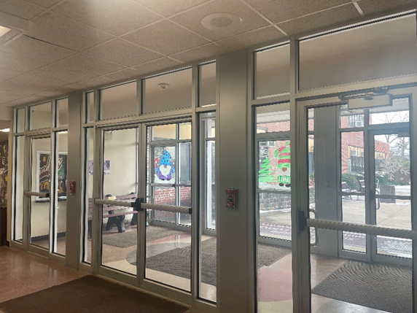
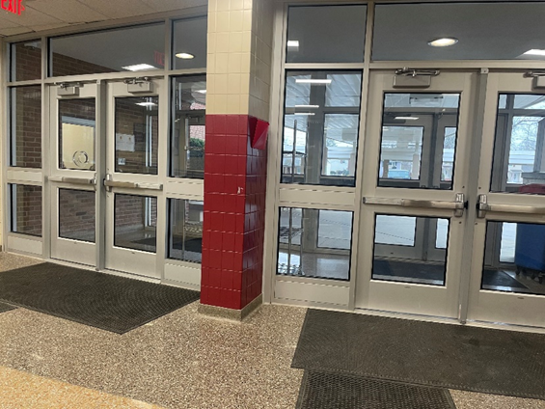
SILAS WOOD & STIMSON SECURITY VESTIBULES
Notes:
Updated 2/2/2024

Slide 16
DISTRICT SAFETY AND SECURITY INITIATIVES Cont’d
Communication Upgrades:
PA Systems at Walt Whitman High School and Stimson Middle School completed this school year
Audit of all walkie-talkies to ensure we can communicate Districtwide in the event of an emergency (purchased new walkie talkies at Birchwood, Stimson, and JKAO)
Law Enforcement Collaboration
2nd Precinct School Resource Officer and Suffolk County Police Department Homeland Security Section provided workshops to District Leadership and Staff
District’s Joint Operations and Emergency Services Task Force worked in conjunction with the Department of Homeland Security to provide Active Shooter Training at WWHS in the Spring of 2023. The Districtwide Safety Committee is working to schedule another training at Stimson Middle School
School Resource Officer is member of the District Safety Committee and actively participates in school emergency drills
Notes:
Updated 2/2/2024

Slide 17
SHUFSD SECURITY PERSONNEL
Safety Officers:
Patrol the inside of all 8 District buildings. Support the smooth functioning of the school day. Continuously monitor districtwide cameras during the school day.
Security:
Patrol each of the 9 campuses throughout the district 24 hours a day 7 days a week. Are an active presence at athletic and after-school events. Continuously monitor districtwide cameras after school hours.
Armed Security:
Maintain an active presence at all 8 District buildings. securing the perimeter and only entering the building in the event of an interior threat to our students and staff.
Notes:
Updated 2/2/2024

Slide 18
FACILITIES PLANNING
This year, as approved by the voters in May of 2023, we have $3,480,000 in “Transfer to Capital” for various projects as listed below:
WWHS Bleachers (addition to 22/23 funding)
WWHS Main Field Comfort Station
WWHS Marine Bio Lab
WWHS Fitness Center
WWHS Robotics Lab/Auto Shop
SMS and WWHS Electronic Message Boards
JKAO Security Vestibule
Notes:
These are all of the projects we received fund for in 23-24 with the Transfer to Capital – 2/5/24

Slide 19
THE BUDGET PROCESS
School budgeting, like personal budgeting, consists of the comparison between anticipated revenues and expenditures.

Slide 20
2023/2024 FISCAL OVERVIEW
Taxation $123,659,569
State Aid $70,459,160
Other Revenues $9,980,000
Total Revenues $204,098,729
Reserve Usage $1,980,000
Appropriated Fund $2,990,000
Balance
Total Expenditures $209,068,729
Notes:
Updated 2/5/2024

Slide 21
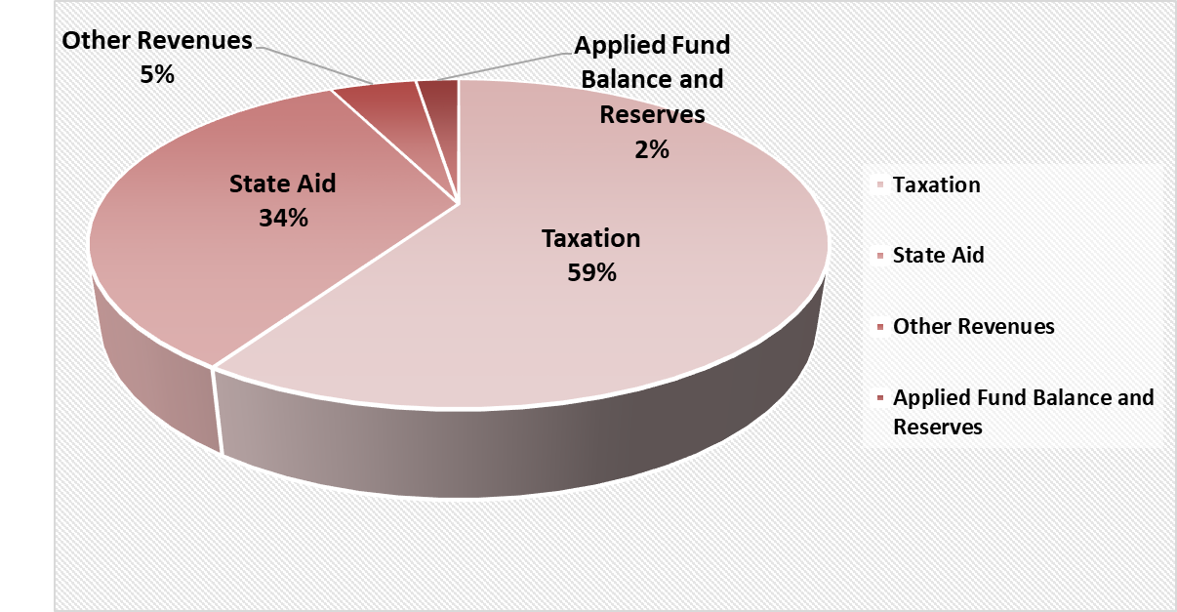
SCHOOL DISTRICT REVENUES
A Review of 2023-2024 Budgeted Revenue Approximations
Notes:
Updated 2/5/2024

Slide 22
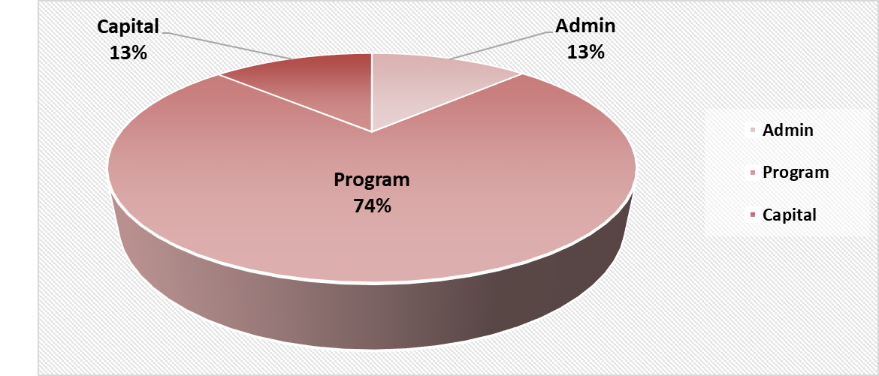
THREE PART BUDGET 2023/24
Admin: $27,158,546
Program: $154,194,873
Capital: $27,715,310
Notes:
Updated 2/5/24

Slide 23
STATE AID CATEGORIES
Foundation Aid
Expense-based Aid

Slide 24
FOUNDATION AID
Foundation Aid was created in 2007 and takes school district wealth and student need into account to create an equitable distribution of state funding to schools.
It is the most substantial aid category supporting public schools.
This budget season, the Governor has proposed two significant changes to Foundation Aid:
Elimination of “Save Harmless”
Inflation Calculation

Slide 25
FOUNDATION AID
Elimination of Save Harmless
For decades, New York State has guaranteed that school districts continue to receive as much operating aid as they received the previous year, regardless of demographic changes.
This has meant that districts who have experienced declining enrollment have not seen declines in their Foundation Aid.
In the Governor's current budget, she has proposed to eliminate this protection.
Notes:
Specifically for Foundation Aid, this has meant that districts who have experienced declining enrollment have not seen declines in their Foundation Aid, as the formula is calculated on a per pupil basis. This is commonly known as the “save harmless” or “hold harmless.”

Slide 26
FOUNDATION AID
Inflation Factor
The Foundation Aid formula has previously used an inflation factor over the previous year. Under current law the adjustment for next year would be 4.1%.
The Governor has proposed to use a multi year average of inflation which will reduce the rate to 2.4%.
This essentially reduces the starting point of the formula and has cut approximately $250 million from the November 2023 projection for all districts.
Notes:
In years when the state’s Successful Schools Study has not been updated, the formula includes an inflation factor over the previous year. Under current law, that adjustment would be a 4.1% increase on the base “Foundation Amount” used in the formula. The governor is proposing to reduce that to 2.4% through a change to a multi-year average of inflation. This action reduces the starting point of the formula for all school districts, and ultimately cuts approximately $250 million from the November Foundation Aid projection across all school districts

Slide 27
EXPENSE BASED AID
Expense based aid is received according to our prior year expenditures.
These types of Aid include categories such as Transportation, BOCES, Building Aid, Instructional Materials Aid.

Slide 28
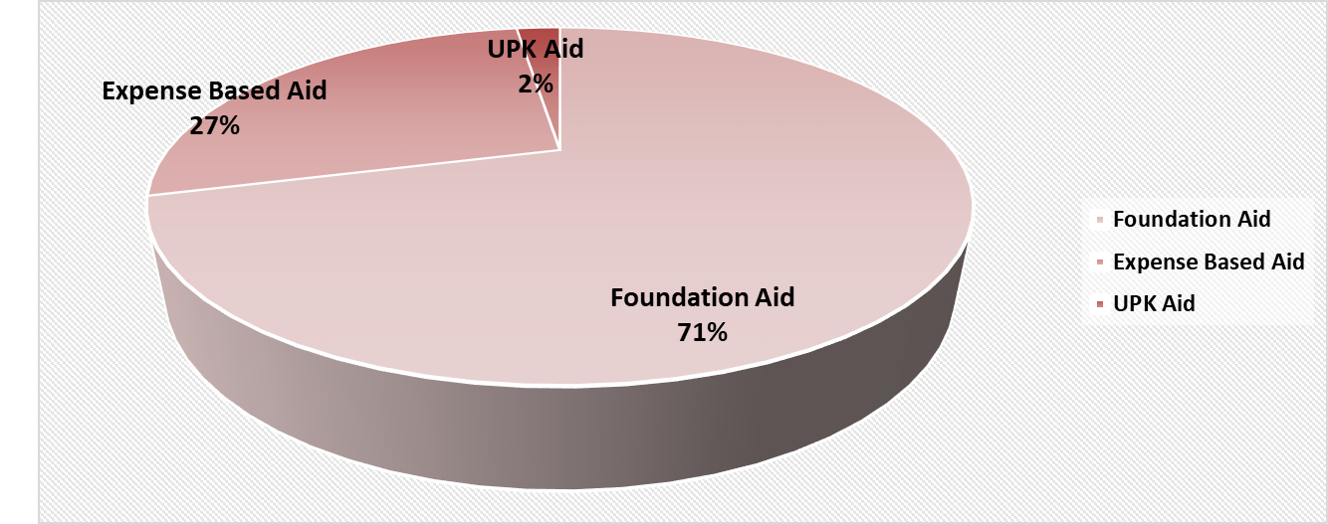
2024/2025: EXECUTIVE STATE AID PROPOSAL
Foundation Aid: $ 54,879,183
Expense Based Aid: $ 20,838,121
UPK Aid: $ 1,794,215
Total Proposed Aid: $ 77,511,519
Notes:
Updated 2-5-24

Slide 29
EXPECTED 2024/2025 COSTS
Pension system rates:
a. ERS – 15.2% (increase of 2.1%)
b. TRS – Estimated 10.02% (estimated increase of 0.26%).
Note: Expenditures are expected to increase as they are a function of salaries.
Healthcare cost challenge: schools have to project the second half of the school year. This remains difficult to project, and from January 2020 to January 2024 we have seen an increase of over 40%; with the average of the last three years over 11%. January of 2024 we received an increase of approximately 9% for active employees.
Notes:
Utility costs are increasing: This figure is appropriately budgeted considering the substantial increase in budget during “covid”

Slide 30
GOALS FOR 2024/2025
Continuous strive for excellence
Provide learning opportunities and meet the academic as well as social-emotional needs of all students
Close achievement gaps
Continuity and expansion of programs
Strengthen community
partnerships
Fiscal sustainability including reducing reserve reliance
Enhancement of safety measures and the upkeep of facilities & grounds

Slide 31
UPCOMING BUDGET PRESENTATION DATES
March 6, 2024: Budget Work Session/Board of Education Meeting, JKAO
March 20, 2024: Budget Work Session/Board of Education Meeting, JKAO
April 16, 2024: Budget Adoption/BOCES Budget Vote/Board of Education Meeting, JKAO
May 7, 2024: Public Hearing of Budget/Board of Education Meeting, JKAO
May 21, 2024
BUDGET/REFERENDUM VOTE & BOARD OF
EDUCATION ELECTION
Walt Whitman High School, 2pm - 9pm
Board of Education Meeting,
Walt Whitman High School, 7:30 pm
Notes:
Updated 2-5-24

